Slide 1

Objectives
In this session, you will learn to:
  Create tables
  Create forms
  Work with frames

Slide 2
Introducing Tables
Tables are used to present data in a tabular format.
Tables provide structured information to the end user.
Tables consist of rows and columns.
The <TABLE> tag is used to create a table.

Slide 3
Introducing Tables (Contd.)
The following table describes the basic tags required to create a table.
Tags | Description
<TABLE> | Specifies the tag for creating a table. The table tag starts with the <TABLE> tag and ends with a </TABLE> tag.
<TH> | Specifies the table header. By default, header cells are in bold and are center aligned. A table header starts with the <TH> tag and ends with the </TH> tag.
<TR> | Specifies the table row. The contents of the row are placed between the <TR></TR> container tags.
<TD> | Specifies the table data that must be written within the <TD></TD> container tags. The <TD> tags are specified within the <TR> tags.
<CAPTION> | Specifies the table caption that can be placed above or below the table. The <CAPTION>…</CAPTION> tag should appear inside the <TABLE>…</TABLE> tag.
<THEAD> | Specifies the table header defined inside the <TABLE> tag.
<TBODY> | Specifies the contents of a table.
<TFOOT> | Specifies the table footer defined inside the <TABLE> tag.

Slide 4
Modifying Table Attributes
Attributes enable you to specify additional formatting information such as the height, width, and border of the tags.
The <TABLE> tag has the following attributes:
  BORDER
  BGCOLOR
  CELLSPACING
  CELLPADDING
  WIDTH
  HEIGHT
  ALIGN
  VALIGN

Slide 5
Modifying Table Attributes (Contd.)
  BORDERCOLOR
  BACKGROUND
  FRAME
  RULES
  The <TD> tag has the following attributes:
    COLSPAN
    ROWSPAN
    BACKGROUND
  The <COLGROUP> tag has the following attributes:
    ALIGN
    VALIGN
    SPAN
  The <CAPTION> tag has the following attributes:
    ALIGN

Slide 6
Demo: Arranging Data by Using Tables
Problem Statement:
  Fun Seasons Corp. is a leading departmental store in New Jersey, United States. The store offers a wide range of products. Recently, the store planned to launch its Web site to showcase its products and services online to attract more customers. Create a Products and Services Web page that displays information such as the Product Code, Product Category, Product Name, Product Price, and Product Description in a tabular format.
  You need to enhance the table created by using the various table attributes.

Slide 7
Demo: Arranging Data by Using Tables (Contd.)
Solution:
  To solve the preceding problem, you need to perform the following tasks:
    Create a table in a Web page.
    Populate the table with information.
    Verify the solution.

Slide 8
Creating Forms on a Web Page
Forms allow you to create interactive Web pages by providing an interface for exchanging information on the Internet.
The <FORM> tag is used to define a form.
The <FORM> tag supports the following attributes:
  NAME
  ACTION
  METHOD
  ENCTYPE

Slide 9
Types of Form Fields
You can add the following types of controls to a form:
  Text box
  Radio button
  Check box
  Buttons
  Select lists
  Text area

Slide 10
Types of Form Fields (Contd.)
The <INPUT> Tag:
  Represents the fields in which the user can edit content.
  The various attributes of the <INPUT> tag are:
    TYPE
    VALUE
    NAME
    CHECKED
    SIZE
    MAXLENGTH
    ALIGN
    SRC

Slide 11
Types of Form Fields (Contd.)
The <SELECT> Tag:
  Is a container tag which allows the user to select one of the options from a drop-down list.
  The attributes of the <SELECT> tag are:
    MULTIPLE
    NAME
    SIZE
The <OPTION> Tag:
  Occurs within a <SELECT> tag.
  Represents one choice.
  Has only two attributes:
    SELECTED
    VALUE

Slide 12
Types of Form Fields (Contd.)
The <TEXTAREA> Tag:
  Enables you to create a field in which the user can enter a large amount of text.
  The <TEXTAREA> tag supports the following attributes:
    ROWS
    COLS
    NAME

Slide 13
Demo: Creating Interactive Web Pages
Problem Statement:
  PlaceMe, Inc. is an upcoming placement consultancy firm based in New York. To increase its database of job seekers, the firm wants to provide a registration form on their Web site, where candidates can enter their personal, educational, and professional details. The form should contain the following fields:
    Login Details:
      User Name
      Password
      Re-enter Password

Slide 14
Demo: Creating Interactive Web Pages (Contd.)
    Personal Details:
      First Name
      Last Name
      E-mail
      Gender
      Phone Number
      Preferred Job Location: User should be able to select multiple job locations.
    Professional Details:
      Experience (in years)
      Job Category: User should be able to select multiple job categories.
      Key Skills
    Educational Details:
      Degree Held
      Specialization

Slide 15
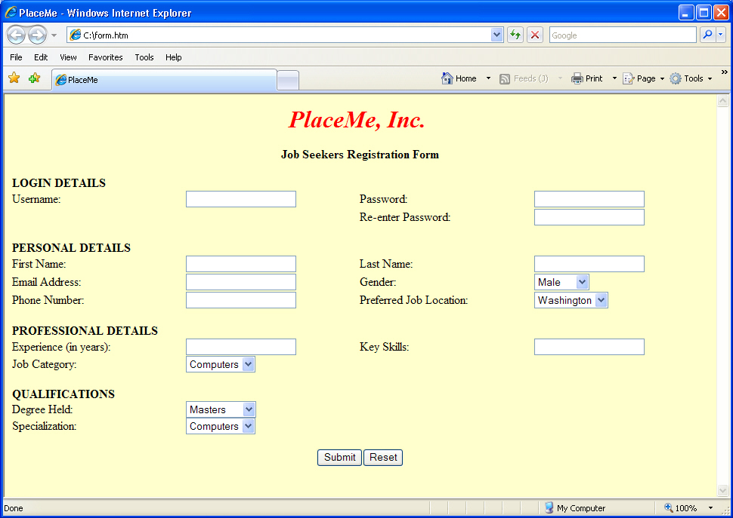
Demo: Creating Interactive Web Pages (Contd.)
  The form should also contain buttons to enable a user to submit or reset the values entered in the various fields.
  The form should have an interface, as shown in the following figure.

Slide 16
Demo: Creating Interactive Web Pages (Contd.)
Solution:
  To solve the preceding problem, you need to perform the following tasks:
    Create a Web form in a Web page.
    Insert the heading section in the Web form.
    Insert the LOGIN DETAILS section in the Web form.
    Insert the PERSONAL DETAILS section in the Web form.
    Insert the PROFESSIONAL DETAILS section in the Web form.
    Insert the QUALIFICATIONS section in the Web form.
    Verify the solution.

Slide 17
Working with Frames
The layout of a Web page can be made flexible by using frames.
Frames divide the client area into multiple sub regions called frames.
The properties of a frame are:
  It can load its own URL, independent of the other frames.
  It can be given a name so that other URLs can target it.
  It can change its size dynamically according to the change in size of the visible client area.
The basic structure of a frame document resembles an HTML document, except that the <BODY> tag is replaced by the <FRAMESET> tag.

Slide 18
Working with Frames (Contd.)
Using Frame Tags:
  A FRAME document is generated by:
    <FRAMESET> Tag
    <FRAME> Tag
  The <FRAMESET> Tag:
    Is the main container tag for the frame.
    The two attributes of the <FRAMESET> tag are:
      ROWS
      COLS

Slide 19
Working with Frames (Contd.)
  The <FRAME> Tag:
    Defines one frame in a <FRAMESET> tag.
    The <FRAME> tag is not a container tag and does not have any matching end tag.
    The various attributes of the <FRAME> tag are:
      SRC
      MARGINWIDTH
      MARGINHEIGHT
      SCROLLING
      NORESIZE
      FRAMEBORDER
      FRAMESPACING
Notes:
The<Frame>Tag defines the HTML document that needs to be displayed in each frame. Explain the functioning of various attributes of the <FRAME> tag.

Slide 20
Working with Frames (Contd.)
  The <NOFRAME> tag is used for creating alternate content that is viewable by nonframe-enabled browsers.
  You can reference a frame by using the following tags:
    NAME attribute of the <FRAME> tag
    TARGET attribute of the <ANCHOR> tag
    The <BASE> tag

Slide 21
Demo: Creating Frames in a Web Page
Problem Statement:
  LeadTheRoad Inc. is one of the leading international travel and tourism group in the United States. The company provides services to customers at almost 100 locations spread across more than 30 countries. Recently, the company has planned to include a Web page on their Web site that will provide information about the popular chains of hotels in various continents, such as Asia, Europe, Australia, and the United States. The list of the continents should always be visible in the browser window.

Slide 22
Demo: Creating Frames in a Web Page (Contd.)
Solution:
  To solve the preceding problem, you need to perform the following tasks:
    Create a Web page that contains the frames.
    Create a Web page for the banner frame of the main.html file.
    Create a Web page for the main frame of the main.html file.
    Create a Web page for the contents frame of the main.html file.
    Create a Web page for the Asia continent.
    Create a Web page for the Africa continent.
    Create a Web page for the North America continent.
    Create a Web page for the South America continent.
    Create a Web page for the Australia continent.
    Create a Web page for the Europe continent.
    Verify the solution.

Slide 23
Summary
In this session, you learned that:
  Tables are used to display data in a tabular format.
  The basic tags required to create a table are:
    <TABLE>
    <TH>
    <TR>
    <TD>
    <CAPTION>
    <THEAD>
    <TBODY>
    <TFOOT>

Slide 24
Summary (Contd.)
  The attributes of the <TABLE> tag are:
    BORDER
    BGCOLOR
    CELLSPACING
    CELLPADDING
    WIDTH
    HEIGHT
    ALIGN
    VALIGN
    BORDERCOLOR
    BORDERCOLORLIGHT
    BORDERCOLORDARK
    BACKGROUND
    FRAME
    RULES

Slide 25
Summary (Contd.)
  Forms allow the user to input data on a Web page.
  Form tags are used to define the contents of a form.
  The <FORM> tag supports the following attributes:
    NAME
    ACTION
    ENCTYPE
    METHOD
  Form elements that can be created in the Web form are:
    Text box
    Radio buttons
    Check box
    Buttons
    Select lists
    Text area

Slide 26
Summary (Contd.)
  The fields of a Web form are created using the <INPUT>, <SELECT>, <OPTION>, and <TEXTAREA> tags.
  The layout of the Web pages can be made flexible by using frames.
  Frames allow the visible client area to be divided into more than one subregion.
  A <FRAMESET> tag is the main container for the frame.
  Some attributes of the <FRAMESET> tag are:
    ROWS
    COLS

Slide 27
Summary (Contd.)
  Some attributes of the <FRAME> tag are:
    MARGINWIDTH
    MARGINHEIGHT
    SCROLLING
    NORESIZE
    FRAMEBORDER
    FRAMESPACING
  The <NOFRAME> tag is used for creating alternate content that is viewable by nonframe-enabled browsers.
  A frame can be referenced by the:
    NAME attribute of the <FRAME> tag.
    TARGET attribute of the <ANCHOR> tag.
    <BASE> tag.

